Slide 1
The 17th of January
Tuesday

Slide 2
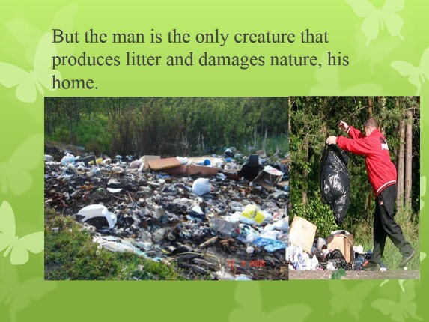
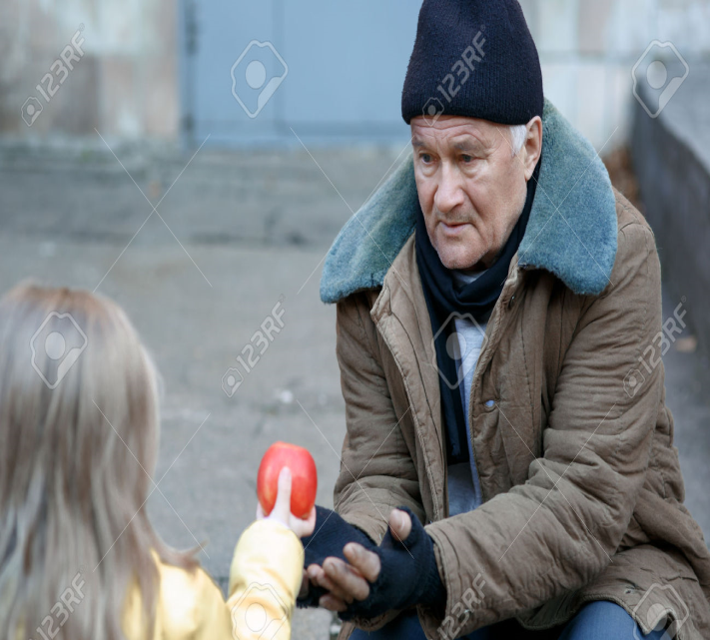
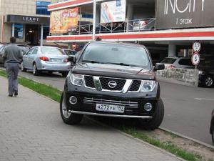
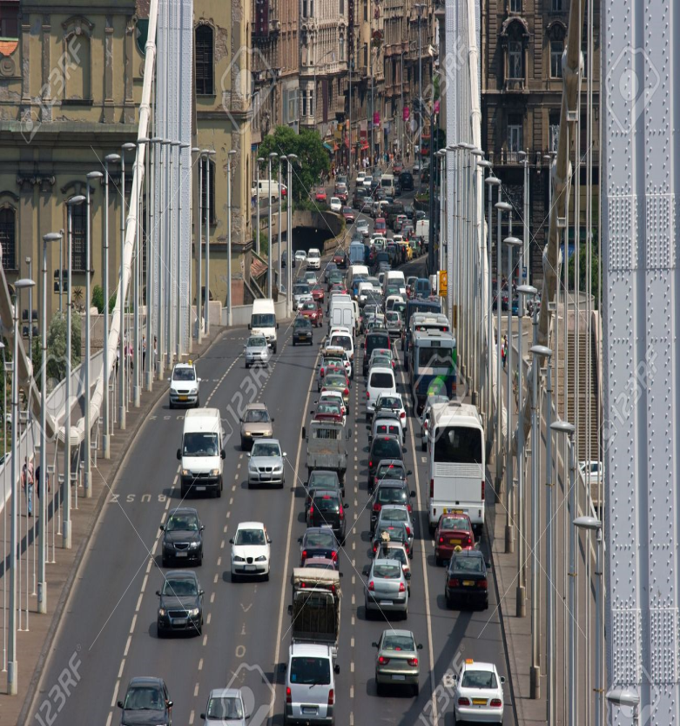
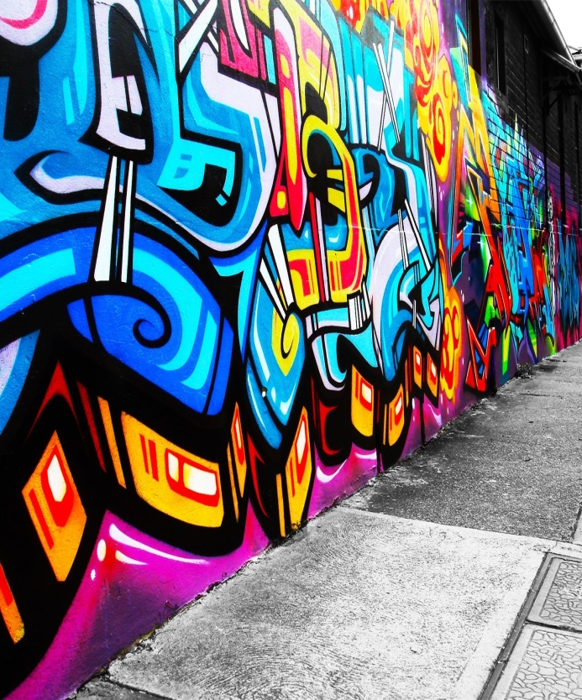


Slide 3
Problems in neighbourhoods

Slide 4
rubbish in the streets, lack of parks/trees,
heavy traffic on the roads, street hawkers,
stray animals, overcrowded public transport,
smells and noise, graffiti, beggars,

Slide 5
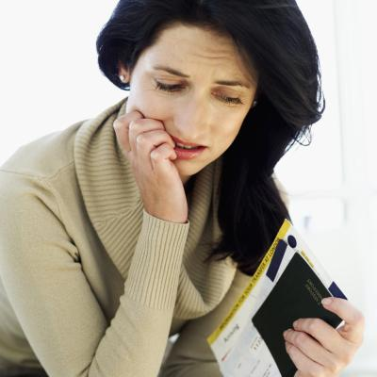
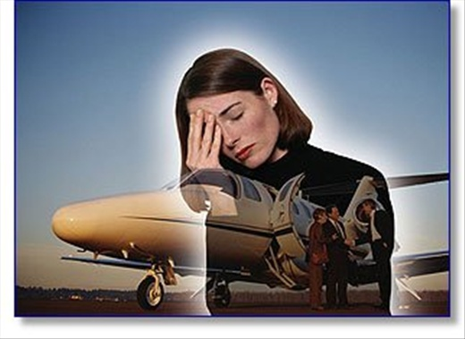
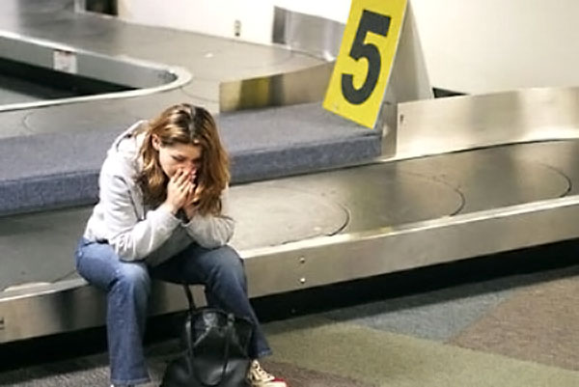

I feel……
nervous
tired
disappointed
angry
worried

Slide 6
H/T
p.87 ex.9,
WB p.37, ex.1-3;
new words and idioms learn by heart

